Slide 1
Advanced Detection of Voltage Control Modes in Power Systems Using: Random Forest Classifications or Simple Euclidean Distance
Project Collaboration: Sam, Richard, & Michael
July/10/24

Slide 2
Project Objective:
The main goal of this project is to identify which mode of voltage control (Volt-VAR, Volt-Watt, Power Factor, or No PV) best matches the given new data. This is achieved by comparing the new data against theoretical graphs for each control mode and using both simple Euclidean distance (baseline) and Random Forest classification methods to determine the most likely control mode.
TLDR: Voltage Control Mode Identification
1

Slide 3
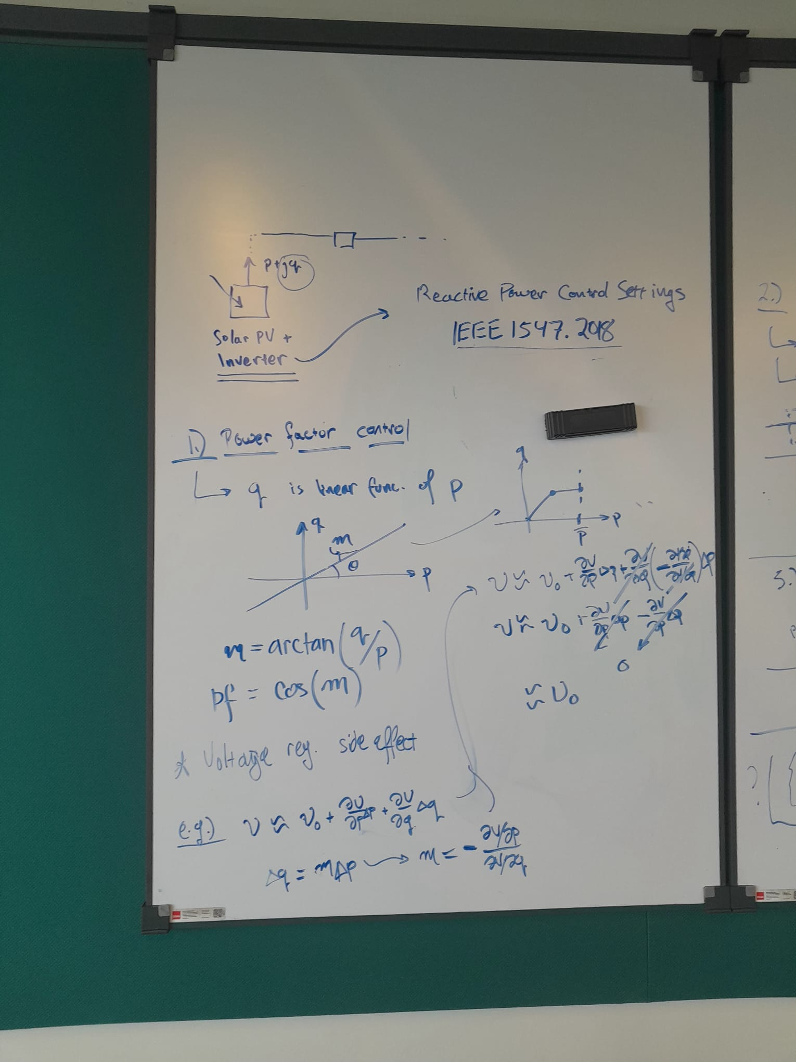
Simple Euclidean Distance Method
Approach:
Generate Synthetic Data: Create synthetic data for each control mode (Volt-VAR, Volt-Watt, Power Factor, No PV) based on theoretical graphs. These graphs are scaled and normalized to ensure proper comparison.
Calculate Euclidean Distance: For the new data, calculate the Euclidean distance between each point in the new data and the corresponding points in each synthetic control mode graph. Sum the distances to get a total distance measure for each control mode.
Determine Best Match: The control mode with the smallest total Euclidean distance to the new data is considered the best match.
2

Slide 4
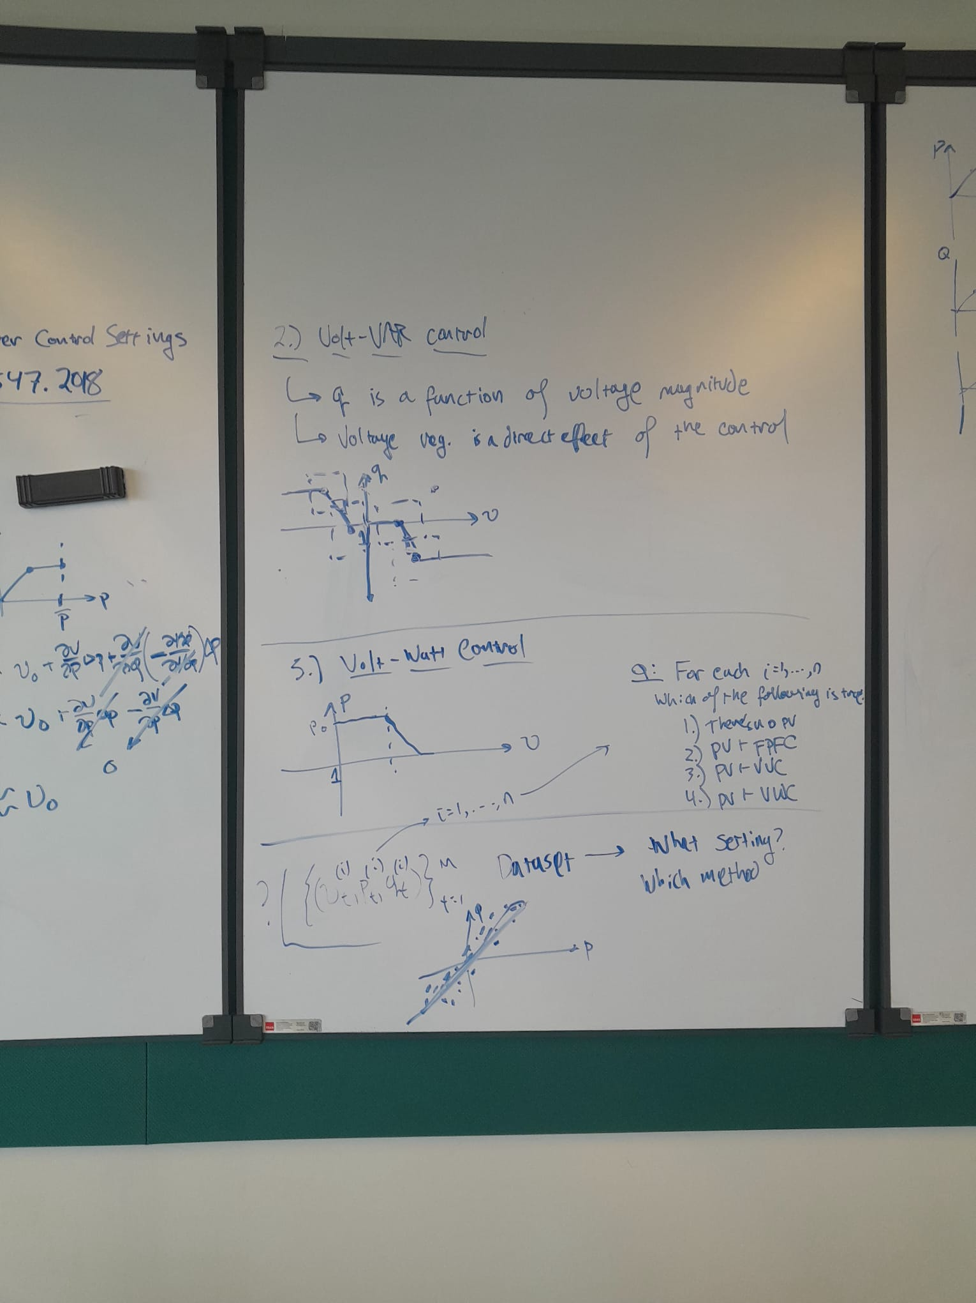
Random Forest Classification Method
Approach:
Generate Training Data: Create synthetic datasets for each control mode with labeled data. Combine these datasets into a single training set.
Train Random Forest Classifier: Use the synthetic training data to train a Random Forest classifier. The classifier learns to distinguish between different control modes based on the synthetic data.
Predict Control Mode for New Data: Use the trained Random Forest model to predict the control mode for the new data. Print the final predicted control mode.
3

Slide 5
Project Update: 1
Understanding the Theory

Slide 6
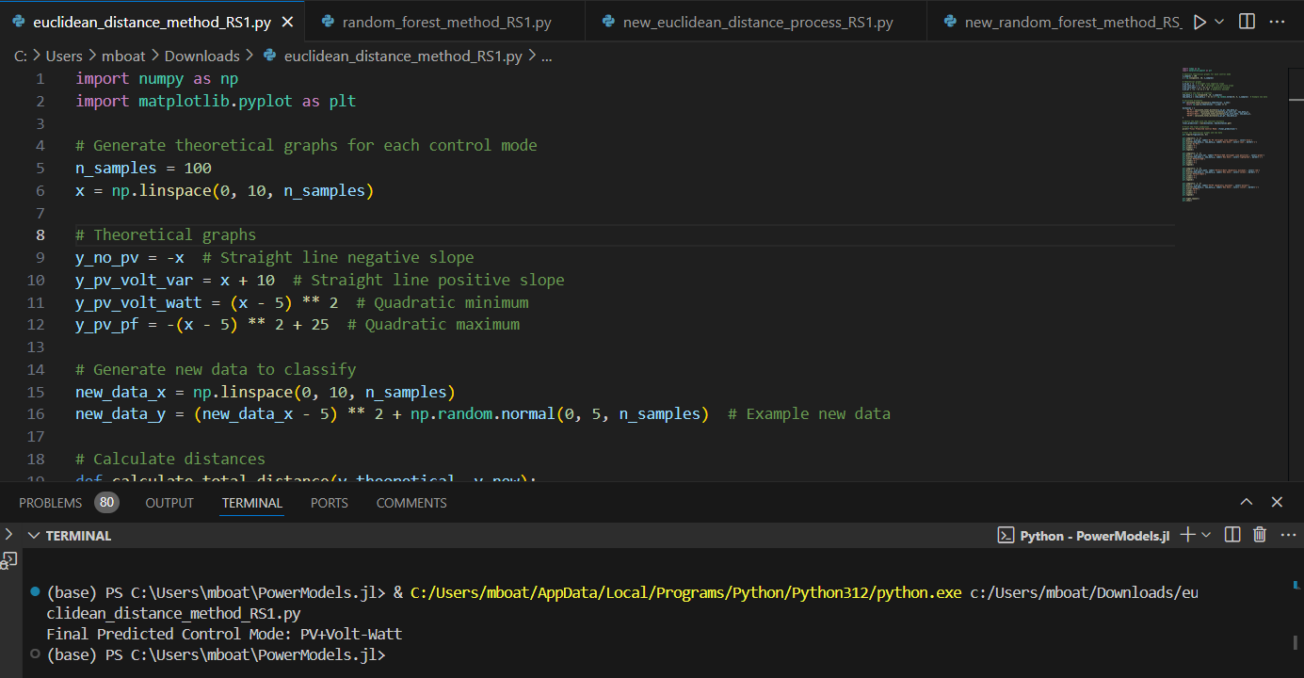
Test Run (Code + Graph)

Slide 7
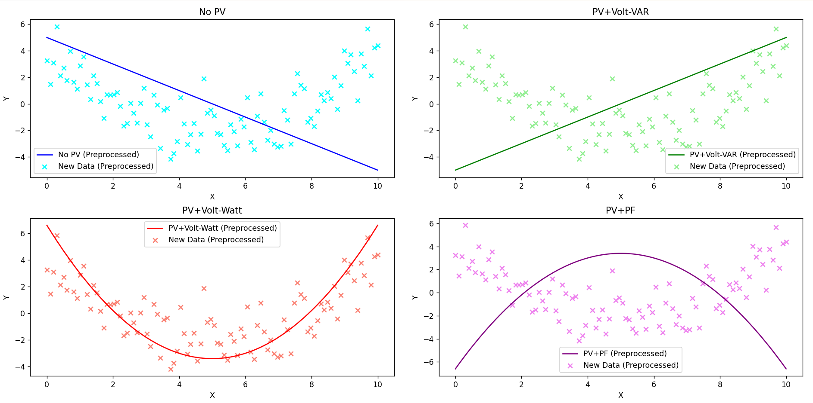
Test Run (Code + Graph)

Slide 8
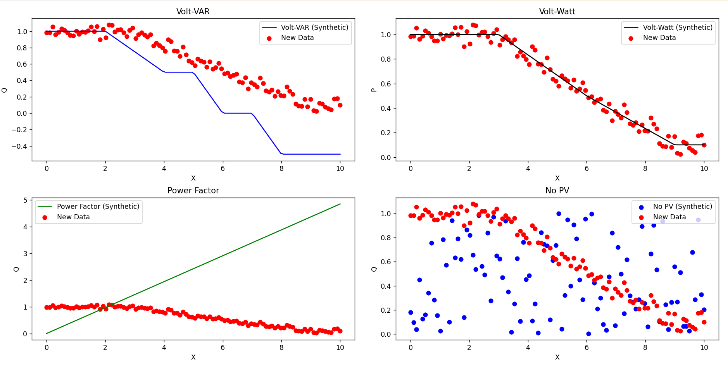
Euclidean Distance (Code + Graph)

Slide 9
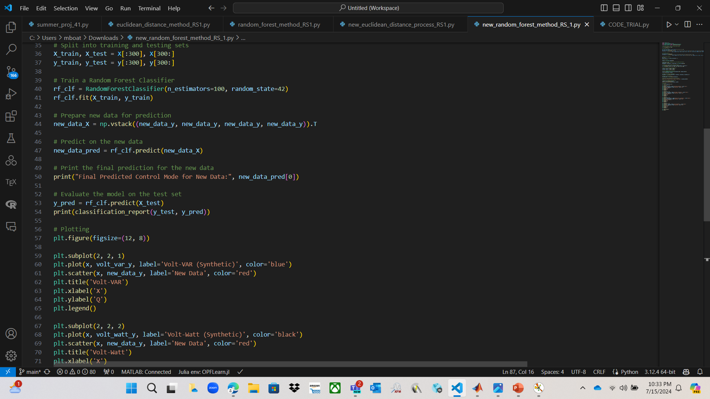
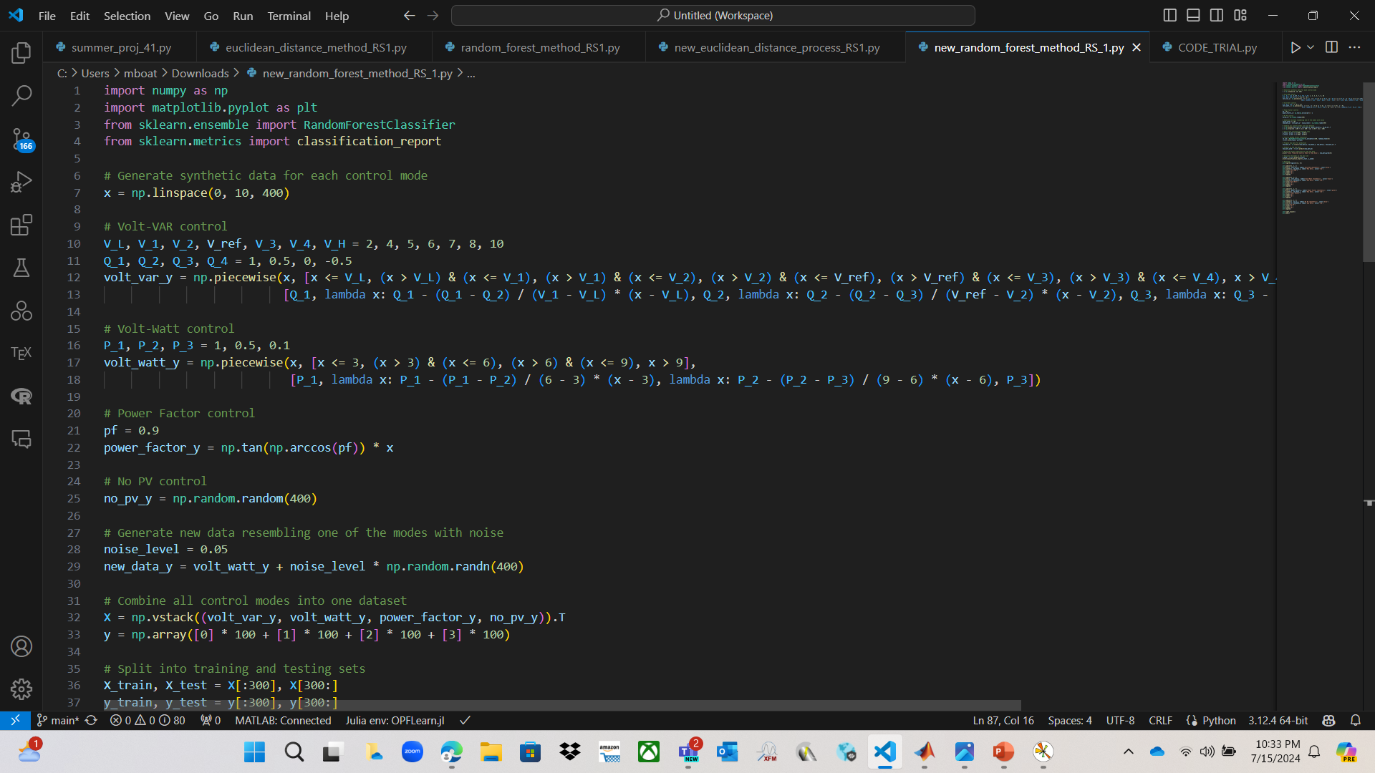
Random Forest (Code + Graph)

Slide 10
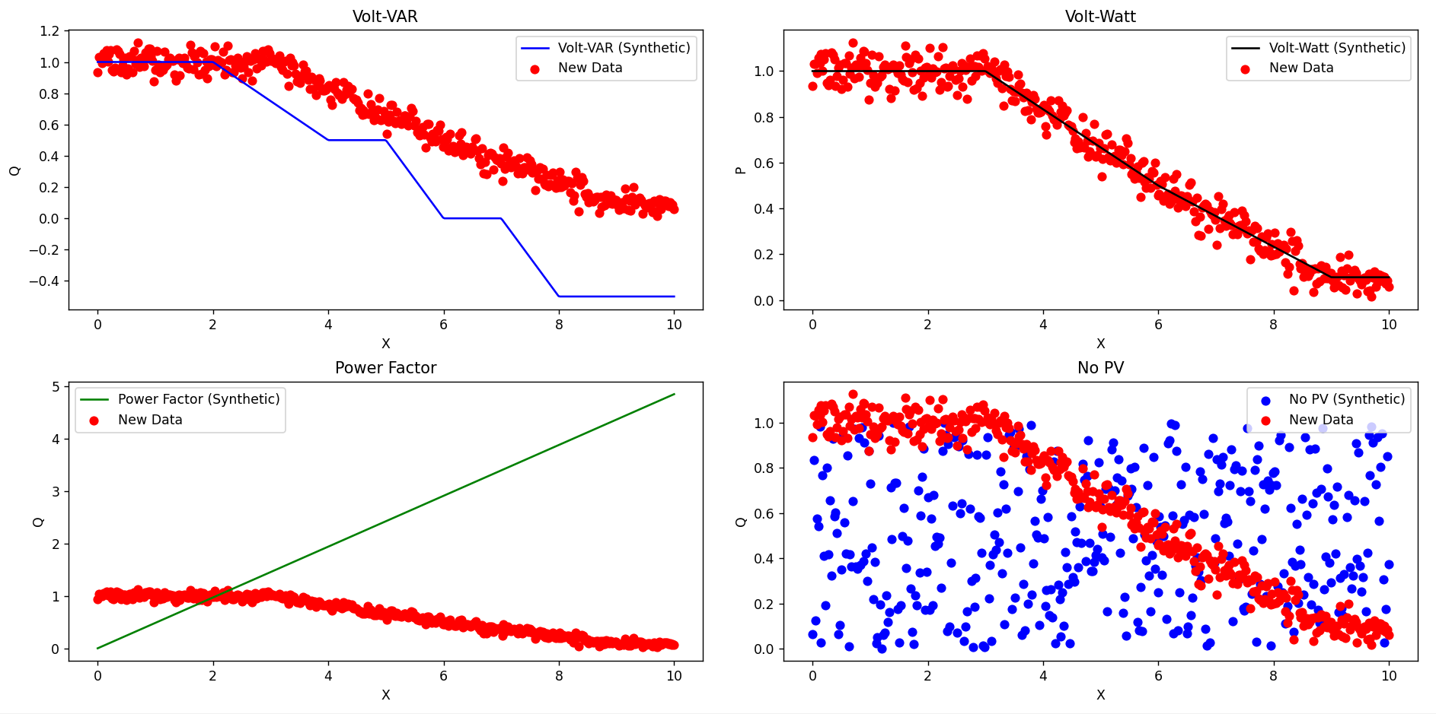
Random Forest (Code + Graph)

Slide 11
Project Update: 2
Exploring the Datasets

Slide 12
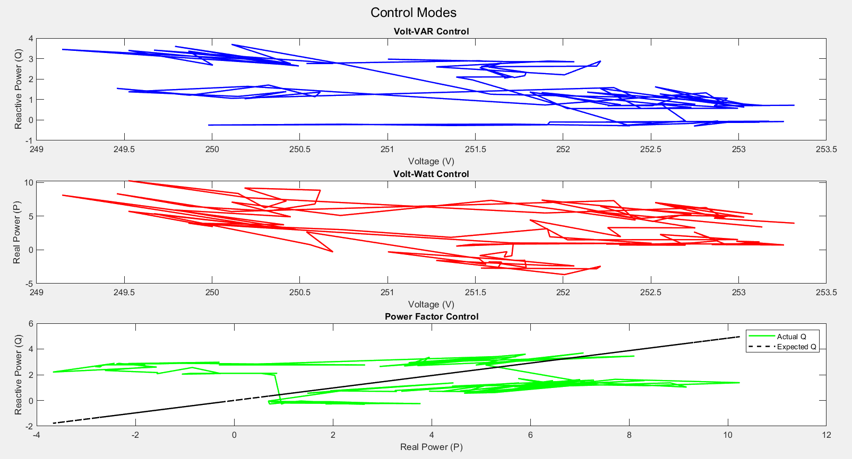
Raw Voltage Control Plots

Slide 13
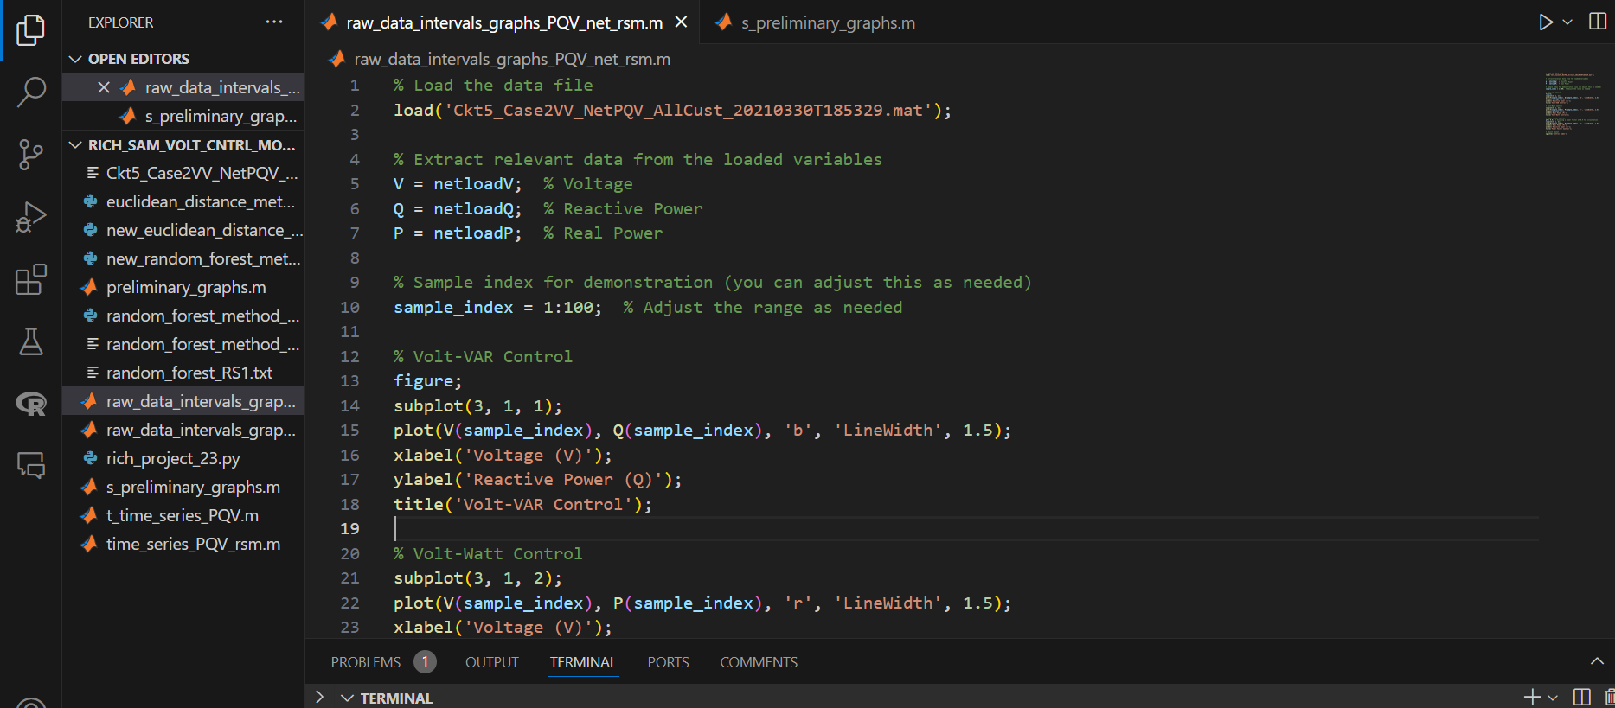
Raw Voltage Control Code

Slide 14
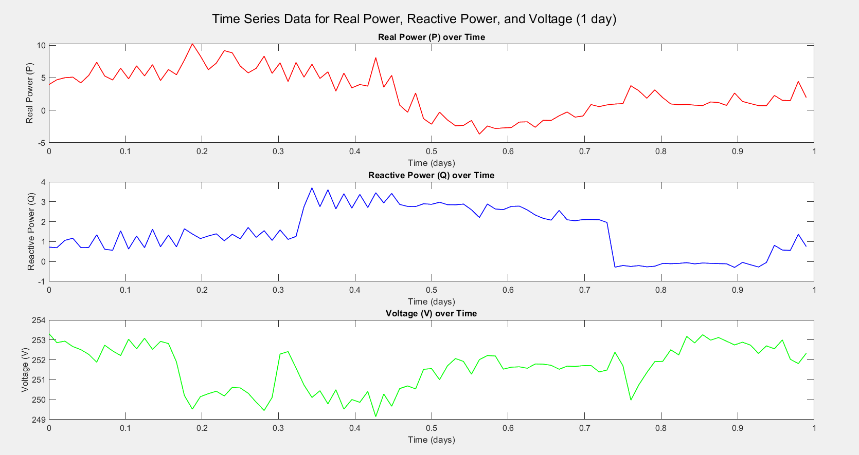
Function to Plot Time Series [in Intervals – 1 day]

Slide 15
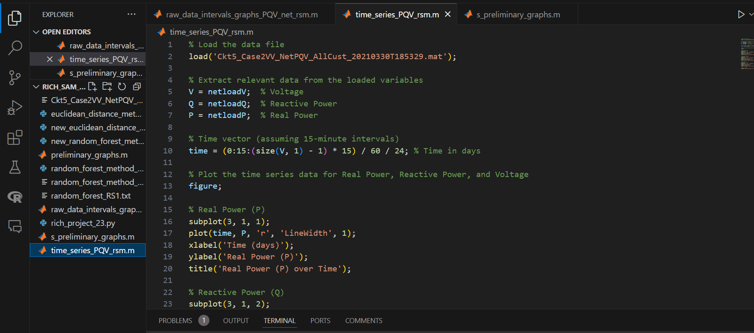
Function to Plot Time Series Code

Slide 16
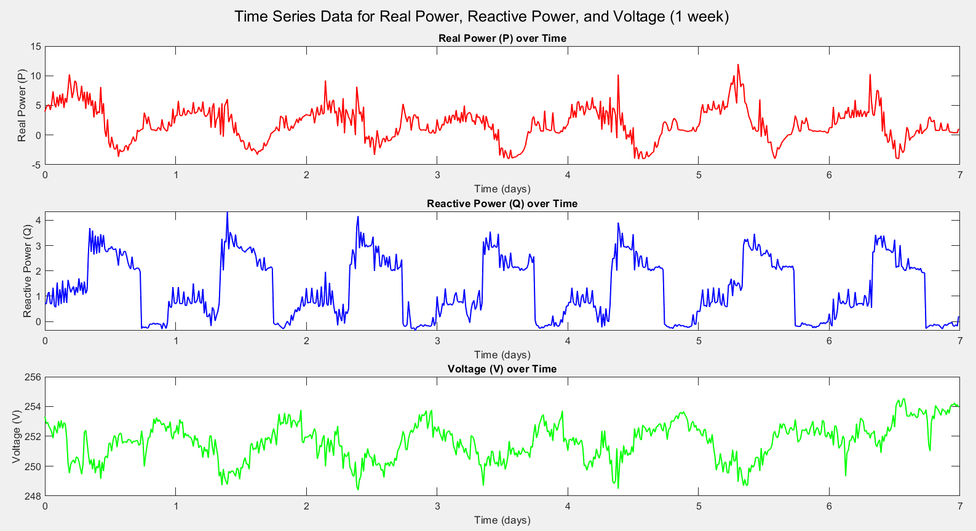
Plotting Time Series [in Intervals – 1 week]

Slide 17
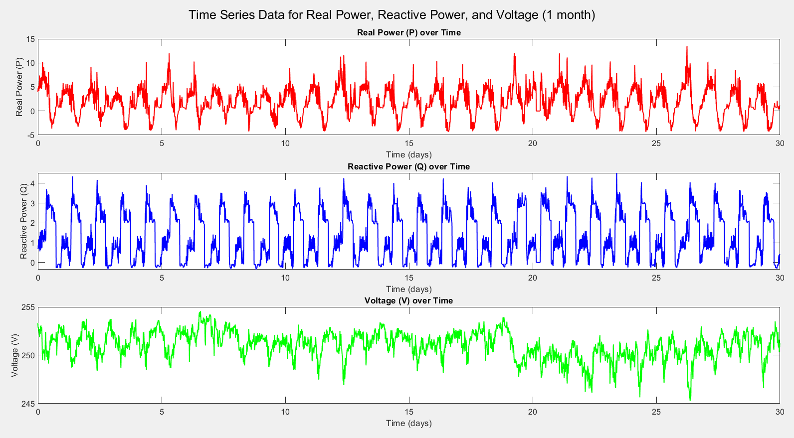
Plotting Time Series [in Intervals – 1 month]

Slide 18
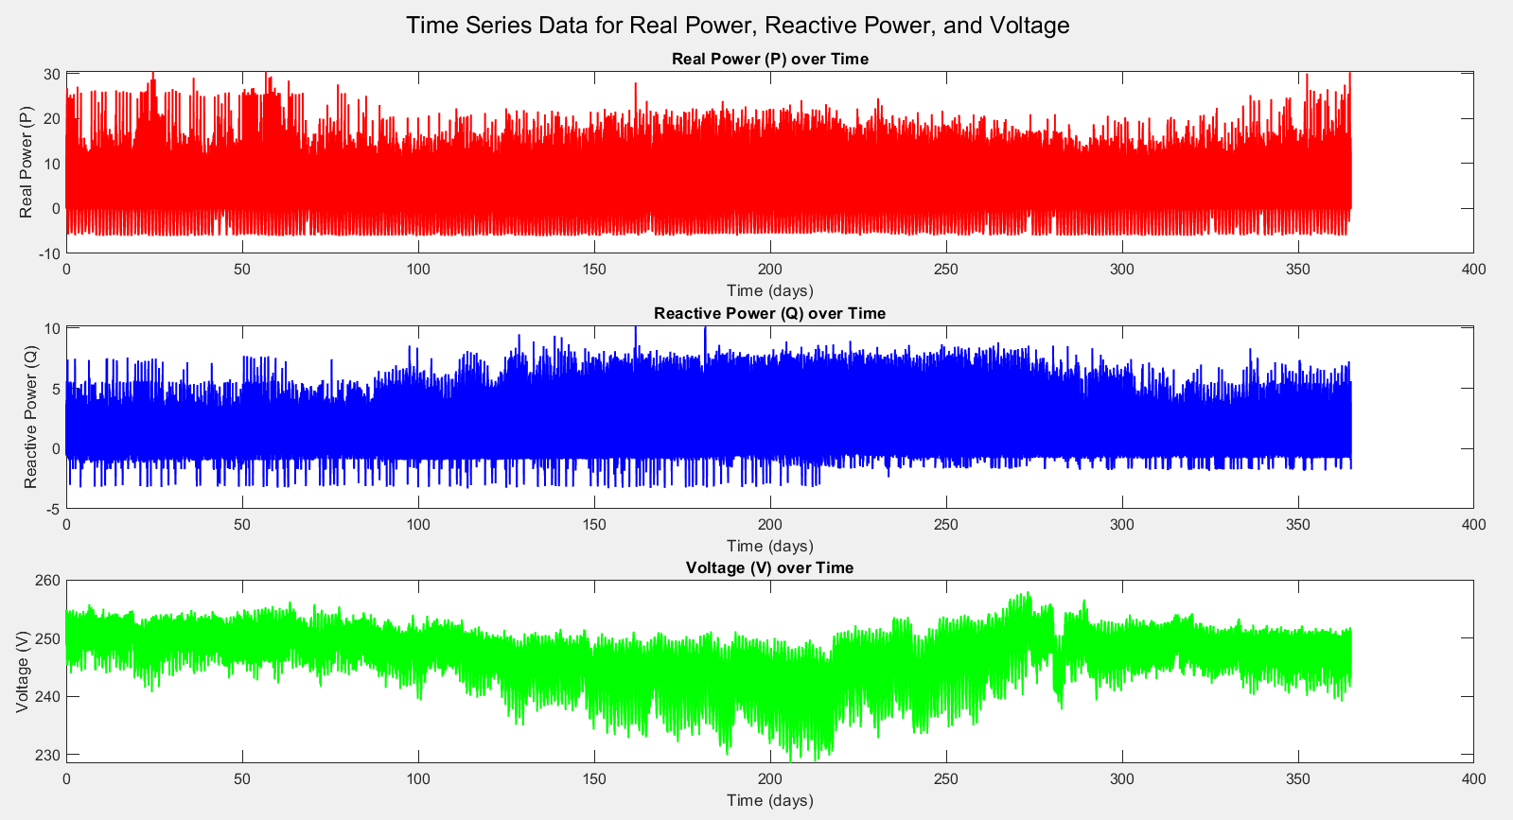
Plotting Time Series [in Intervals – 1 year]

Slide 19
Plotting Time Series [in Intervals – 1 month]

